Slide 1
Security Analytics IIESOC
Dharmanandana Reddy. P

Slide 2
Agenda
Threats – Traditional Security
Security Analytics Introduction
Security Analytics Architecture
Security Analytics Use cases
Security Analytics Challenges
IETF Focus on Security Analytics

Slide 3
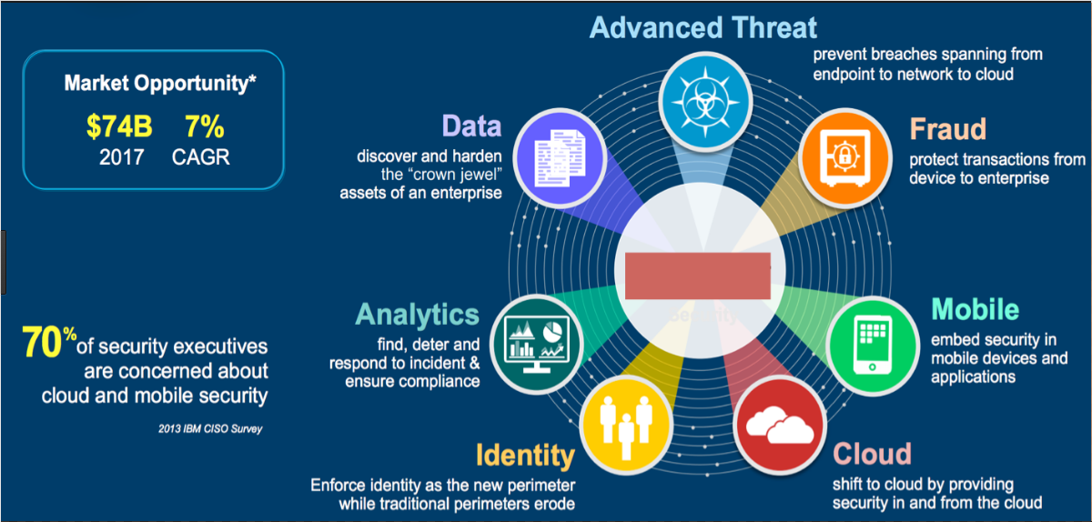
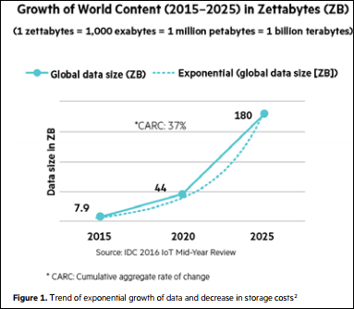
Threats – Traditional Security Tools
Traditional security tools such as DLP and SIEM, helps to detect unusual behaviors
Traditional Security Tools are ineffective to detect and prevent APT
Threats before largely static and long-lived, rely on simple signature-based techniques but Threats now dynamic and short-lived
Cloud computing and IoT entities need security monitoring.

Slide 4
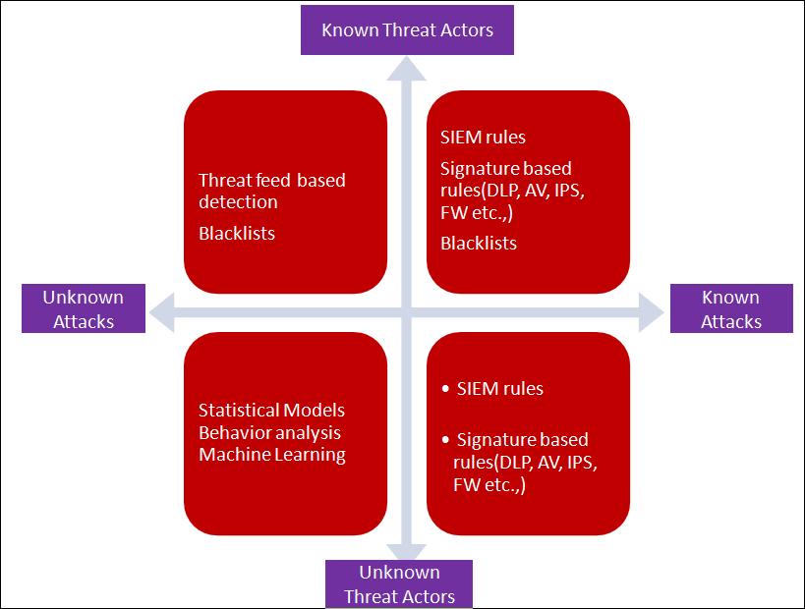
Threat Landscape
Threat landscape can be mapped using a grid with two dimensions
Signature, rules, and threat intelligence fail when it comes to detecting unknown attacks from unknown threat actors
Undetected attackers can stay within the network for longer, falls into APT
Dangerous threat landscape, so need to automate anomaly detection

Slide 5


Security Analytics
SA platform gathers and analyzes data to provide visibility into potential security threats.
SA platform uses math and science techniques to detect known and unknown threats in huge data sets
ML employs statistical techniques and computer algorithms to make models of benign and malicious activity and then refines those models based on new information.

Slide 6
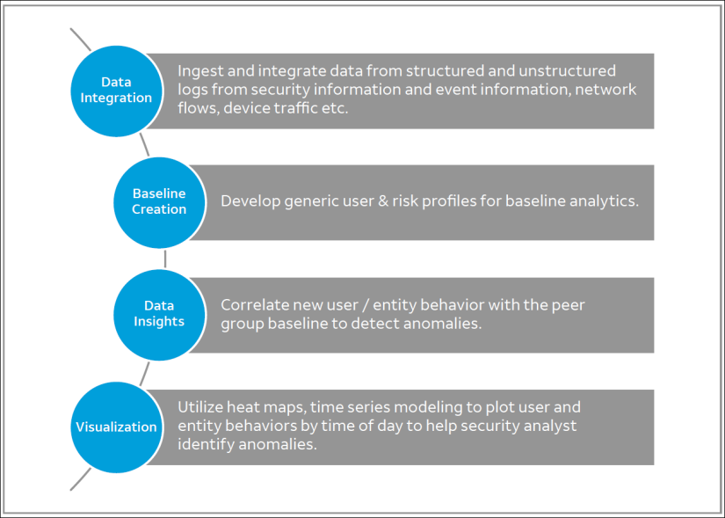
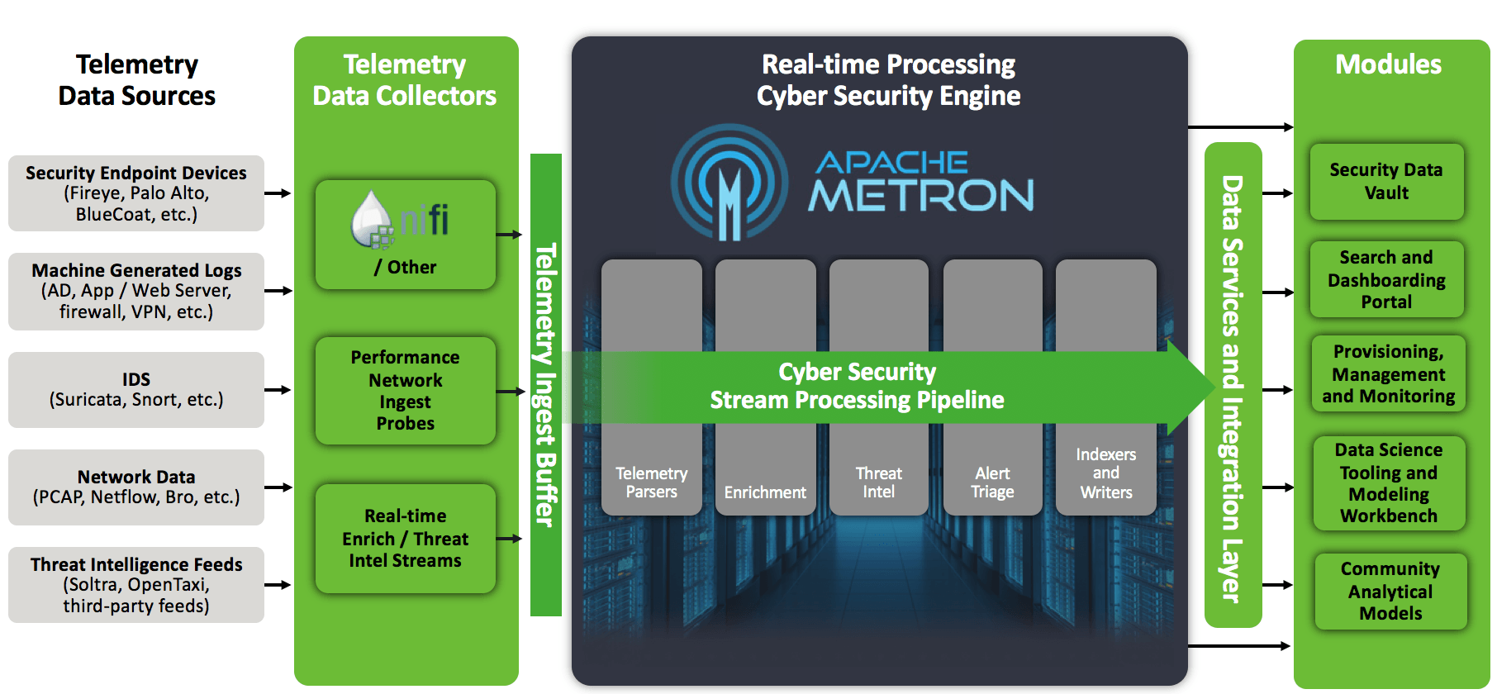
Security Analytics - Architecture

Slide 7
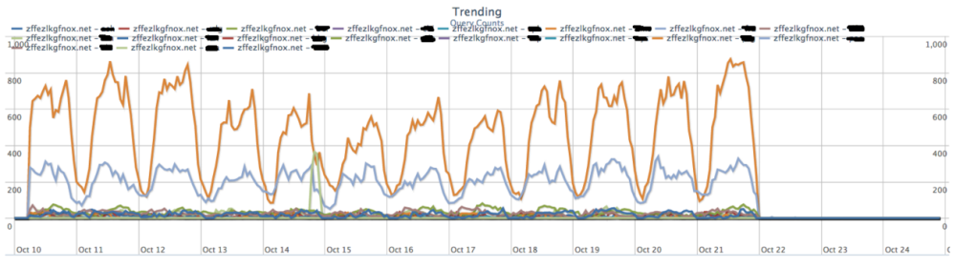
Security Analytics Usecase1 Detection of Malware Beaconing
SIEM,IPS, AM, WAF cannot detect unknown malware
Sandbox technology approach not working
Attackers use unknown C&C servers, use beaconing tactics with unknown pattern of size and frequency.
Analytics use entropy techniques to detect heartbeat.

Slide 8
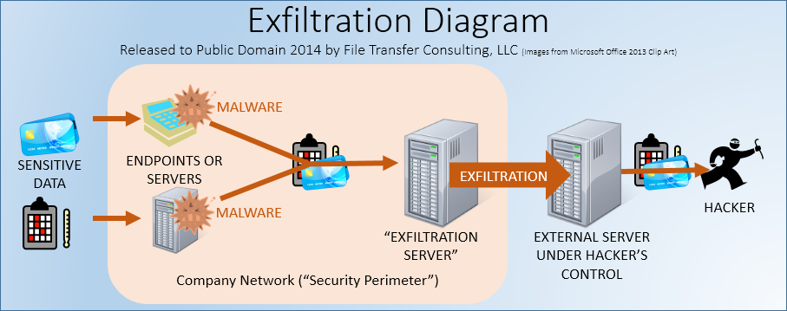
Security Analytics Usecase2 Data Exfiltration
Standard solutions detects leakage if data pattern known: For instance, card info
SA detect new scenarios in data leakage.
HTTP POST for data exfiltration.
base line HTTP POST traffic, detect abnormal traffic
similar techniques to data exfiltration in emails

Slide 9
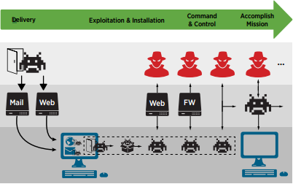
Security Analytics Use case 3 DNS Tunneling / Exfiltration
Ex: Framework POS malware uses DNS Tunneling technique to exfiltrate stolen cardholder data
Baseline the domain field in the DNS query with the domains that occur frequently
An unusual amount of entropy present in the sub domain field of DNS Query

Slide 10
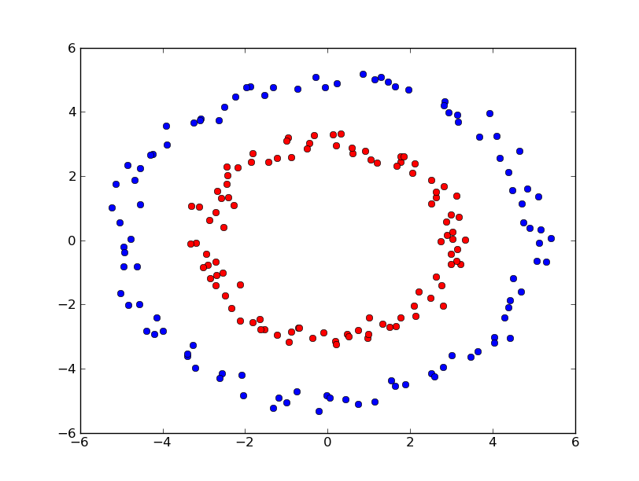
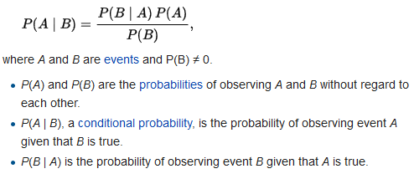
Security Analytics Use case 4 Email spam detection
Spam filters blacklist certain addresses
Features Indicative of Spam
Intentionally misspelled words ("V!AGR4“)
presence of hyperlinks to known malicious websites
virus-laden attachments are likely features
common technique for forecasting – use historical data
ML Models - compare verified spam emails with verified legitimate email
ML Naïve Bayes Theorem

Slide 11
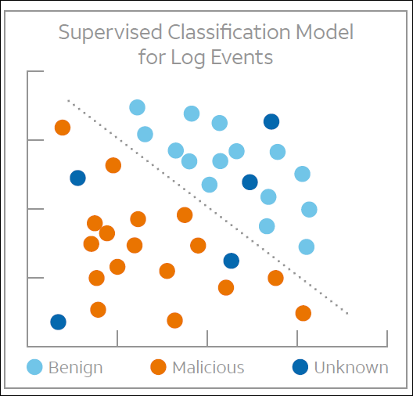
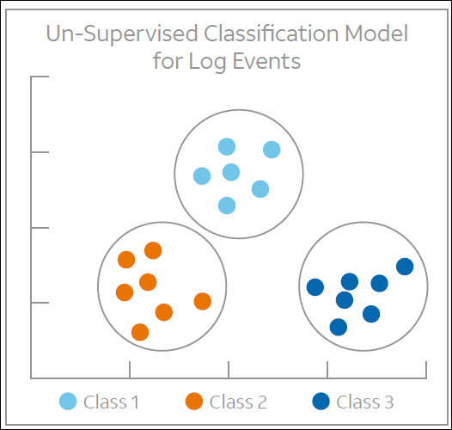
Machine Learning in Security Analytics
ML classification/learning techniques
Supervised Learning
Unsupervised Learning
Reinforcement Learning
(below ML approaches can be used in above learning)
Popular ML methods/approaches
Bayesian analysis
Logistical regression
Simple linear regression
K-means clustering
Decision Trees
Random Forests
Artificial Neural Networks
Apriori Algorithm
Nearest Neighbors
Two machine learning algorithms most often in security analytics -- K-means clustering and simple linear regression

Slide 12
Security Analytics Challenges
useful data from multiple sources
Currently, majority of machine learning approaches in cyber security is used as a type of “warning” system.
Machine learning models – Lower False Positive and negatives rates
Structured Approach to understand the problem and necessity of security analytics
Accuracy, performance, and complexity.
High level skills in development, mathematics and statistics are required.

Slide 13


Security Analytics: Guidance & Standards From IETF
Advanced threats use Internet application protocols (HTTP, DNS, SMTP etc.,) as carriers to attack organizations.
Shift from prevention to prediction and remediation
Systematic and structured approach for security analytics
Security analytics has been trending in recent years
Request IETF to focus on Machine learning, Deep Learning techniques to detect, classify, analyze and remediate advanced threats
New working groups on security analytics or generate discussion about security analytics topic inside IETF community.

Slide 14
thank you!

